Slide 1
Smart Control Of Traffic Lights Using AI
BATCH NO : 05
GUIDED BY : DR.B.PRIYANKA(ASSISTANT PROFESSOR)
TEAM MEMBERS :
R.VARSHITHA 23N35A6615
S.AKSHAYA 23N35A6617
Y.DEVI SRI CHARAN 22N31A66K1

Slide 2
AGENDA
ABSTRACT
INTRODUCTION
EXISTING SYSTEM
LIMITATIONS OF EXISTING SYSTEMS
PROPOSED SYSTEM
ARCHITECTURE DIAGRAM
UML DIAGRAMS
CONCLUSION
REFERENCES

Slide 3
ABSTRACT
Traffic light management is one of the intense technical hazards of the urban areas in almost every country around the world. This is due to speedy increase in number of vehicles in order to decrease the time and complexity. The project developed by us will enable the traffic light to switch from red to green based on traffic density. The easy way to control a traffic light by using timer for each section since, we proposed a system for controlling the traffic light by image processing. The system can notice vehicles through pictures and also the image sequence can then be analyzed victimization digital image process for vehicle detection, and in line with traffic conditions on the road stoplight will be controlled.

Slide 4
INTRODUCTION
In India traffic is enlarge four times faster than population. Nowadays, so many countries suffer from the traffic congestion issues that affect the transportation method in cities and cause serious trouble. Even though replacing traffic officers and custodian by automatic traffic systems, the optimization of the heavy traffic jam is still a big issue to be faced, especially with several junction nodes. Traffic jams also build many other critical issues and problems which straightly affect the human routine lives and sometime reason for death for example if there is an emergency vehicle like a ambulance on the roadway going with critical patient. In that situation if an ambulance gets stuck in a large traffic jam then there are high chances that the patient can't reach the hospital on time. It is very key to design an advanced traffic system which controls traffic intelligently to avoid accidents, collisions and traffic jams. If one path has less traffic and the other path with high traffic but the duration of green light for both paths is same then this is the waste of available time and is inefficient. By considering the above example if the path with higher traffic density should glow green signal light for a longer period than the path with lesser density. This technique is based on the calculation of the traffic density by correlating the live traffic image with a reference image. The large difference is, higher traffic density is noticed.

Slide 5
EXISTING SYSTEM
In India traffic is enlarge four times faster than population. Nowadays, so many countries suffer from the traffic congestion issues that affect the transportation method in cities and cause serious trouble. Even though replacing traffic officers and custodian by automatic traffic systems, the optimization of the heavy traffic jam is still a big issue to be faced, especially with several junction nodes. Traffic jams also build many other critical issues and problems which straightly affect the human routine lives and sometime reason for death for example if there is an emergency vehicle like ambulance on the roadway going with critical patient. In that situation if an ambulance gets stuck in a large traffic j am then there are high chances that the patient can't reach the hospital on time. It is very key to design an advanced traffic system which controls traffic intelligently to avoid accidents, collisions and traffic jams.

Slide 6
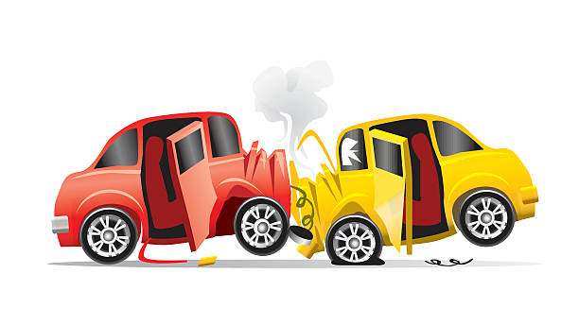
LIMITATIONS OF EXISTING SYSTEM
LESS ACCURACY
MORE POLLUTION
TIME COMPLEXITY
DATA QUALITY AND AVAILABILITY
SCALABILITY
PUBLIC ACCEPTANCE

Slide 7
PROPOSED SYSTEM
Our proposed system aims to present a traffic light controller based on Computer Vision that can adapt to the current traffic situation. It uses live video feed from the CCTV cameras at traffic junctions for real-time traffic density calculation by detecting the vehicles at the signal and setting the green signal time accordingly.
The vehicles are classified as car, bus/truck, or rickshaw to obtain a more accurate estimate of the green signal time. We have used object detection like computer vision in order to detect the number of vehicles for each direction.
We then set the timers of these traffic signals according to vehicle density in each direction and hence the system becomes adaptive. This helps to optimize the green signal times, and traffic is cleared at a far quicker rate than a static system, therefore reducing the unwanted delays, congestion, and waiting time, which in turn will reduce the fuel consumption and pollution

Slide 8
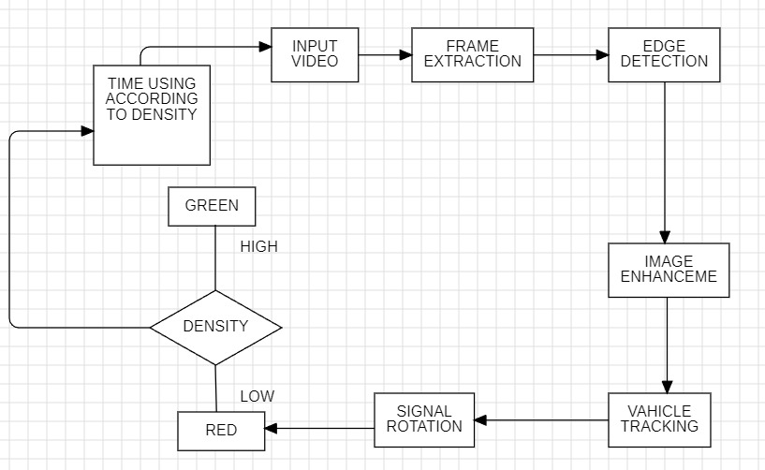
ARCHITECTURE DIAGRAM

Slide 9
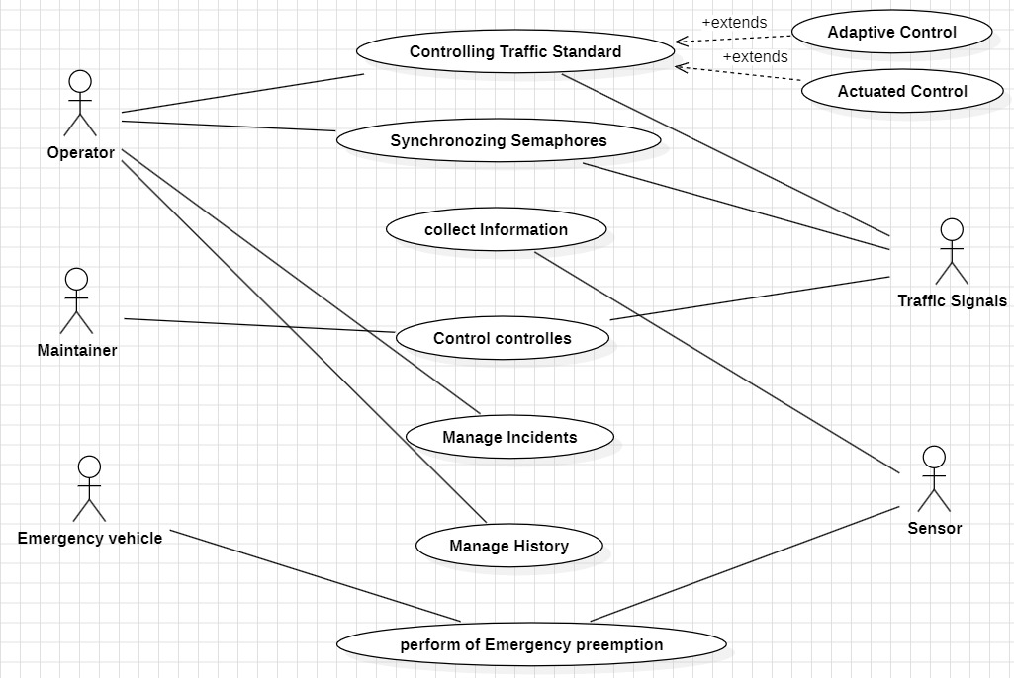
USE CASE DIAGRAM

Slide 10
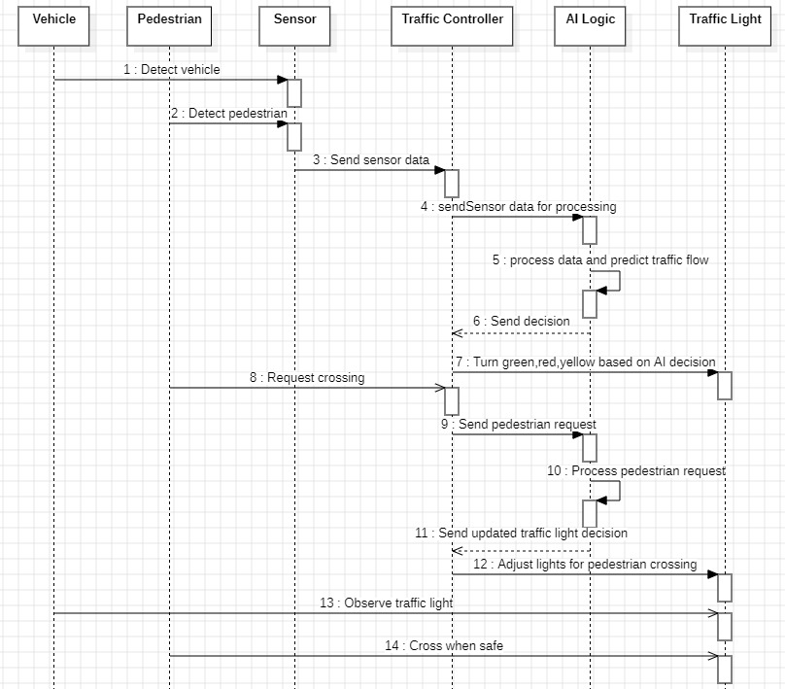
SEQUENCE DIAGRAM

Slide 11
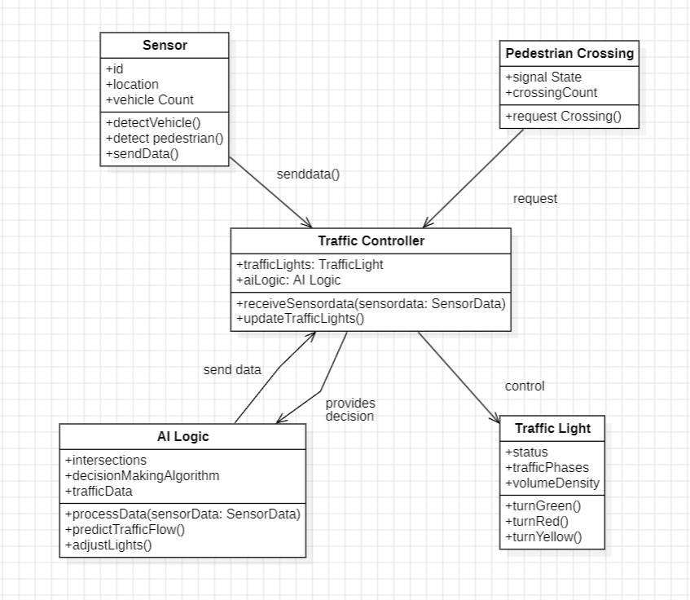
CLASS DIAGRAM

Slide 12
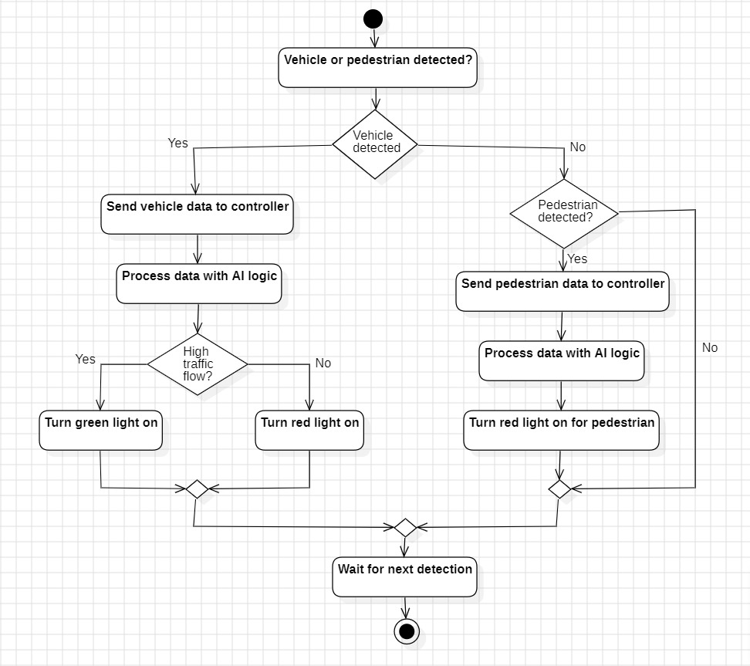
ACTIVITY DIAGRAM

Slide 13

CONCLUSION
This provides a solution to reduce traffic congestion on roads overriding the older system of hard coded lights which cause unwanted delays. Reducing congestion and waiting time will lesser the number of accidents and also reduces fuel consumption which in turn will help in controlling the air pollution. Moreover, the purview of our project can be augmented for Coordination Control which places traffic signals on a coordinated system so that drivers encounter long strings of green lights.

Slide 14
REFERENCES
[1] "Traffic Signal Control Using Artificial Intelligence: A Review "Authors: Mohsen Sargolzaei, Fei Yan, Jia Li,
Mohammad Nasir Uddin, Haiying ShenJournal: IEEE AccessYear: 2018DOI: 10.1109/ACCESS.2018.2867262

